Slide 1
IBM University Engagement Project Submission
“Exploring the Power of Agentic AI with IBM Granite and LangFlow”

Slide 2
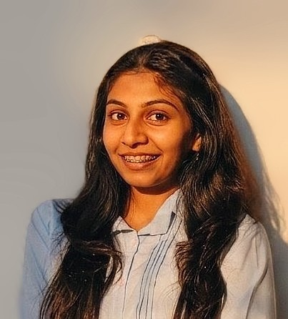
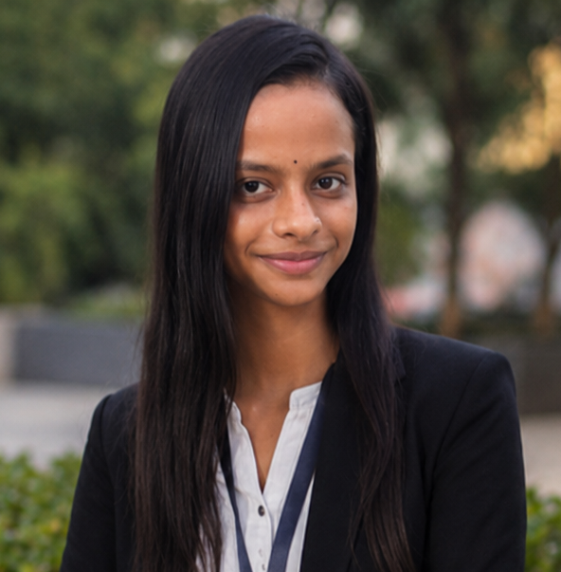

Project Title – AI Driven Cyclone and Coaster Disaster Early Warning Prediction System
Domain of Project – Disaster Management
Student Name | Recent Passport Photo | Email ID | Mobile number [WhatsApp]
Ushma Patel Khushi Pancholi Esha Parekh |  | ushma.sp@gmail.com khpancholi29@gmail.com parekhesha489@gmail.com | 8160929028 9429673141 9316178547

Slide 3
Problem Statement - AI-Driven Cyclone & Coastal Disaster Early Warning System
The Challenge
Gujarat’s 1,600+ km coastline is highly vulnerable to cyclones (e.g., Tauktae, Biparjoy), yet coastal communities and fishermen often receive delayed or generalized warnings, leading to preventable loss of life, boats, and property. Fragmented data and slow communication chains cost precious hours when every minute matters.
The Objective
Build Agentic AI solutions that provide hyperlocal cyclone tracking, fishermen safety alerts, and coordinated evacuation and relief planning for Gujarat’s coastal districts. The solution should:
Real-Time Cyclone Intelligence – Track wind speed, intensity, pressure and landfall probability using live meteorological and satellite data.
Fishermen Safety Alerts – Deliver vessel-specific recall alerts and danger-zone warnings to fishermen at sea.
Coordinated Evacuation & Relief – Plan phased evacuation routes and optimize distribution of food, medical aid and rescue resources.
[To be Continued]

Slide 4
[Cont]
Post-Disaster Assessment – Rapidly assess building, road and agricultural damage to accelerate recovery and aid allocation.
Suggested AI Agents –
Cyclone Track & Intensity Prediction Agent (predicts wind speed, path and landfall probability)
Fishermen Safety Alert Agent (monitors vessel positions and issues recall alerts)
Evacuation Route Planning Agent (plans phased, congestion-aware evacuation routes)
Relief Resource Coordination Agent (optimizes food, medical and rescue resource distribution)
Post-Disaster Damage Assessment Agent – assesses infrastructure and agricultural damage for faster recovery.

Slide 5
Proposed Solution -
The proposed solution is a multi-agent Agentic AI system built using Langflow, IBM Granite LLM, IBM Bob, and IBM Cloud to provide hyperlocal cyclone tracking, fishermen safety alerts, and coordinated disaster response for Gujarat’s coastal communities. The system addresses delayed warnings, hyperlocal risk gaps, and fragmented relief coordination through an intelligent, modular architecture.
At its core, the solution uses a Retrieval-Augmented Generation (RAG) pipeline to fetch accurate, real-time cyclone and coastal data from sources such as IMD, INCOIS, and satellite feeds. This data is embedded and stored in a vector database, enabling the system to retrieve and summarize wind speed, pressure, and landfall risk using Granite models.
The system consists of five key agents:
Cyclone Track & Intensity Prediction Agent predicts wind speed, path, pressure and landfall probability using live meteorological and satellite data.

Slide 6
[Cont]
Fishermen Safety Alert Agent tracks vessel locations and issues real-time recall alerts to vessels approaching high-risk zones.
Evacuation Route Planning Agent analyzes population density, shelter capacity and traffic to generate phased, congestion-aware evacuation plans.
Relief Resource Coordination Agent and Post-Disaster Damage Assessment Agent jointly optimize distribution of food, medical kits and rescue boats, and assess building, road and agricultural damage to accelerate recovery.
The solution includes a live Command Center dashboard (built with React) that visualizes real-time cyclone risk, active alerts, evacuation progress, and relief resource allocation across coastal districts.
Langflow is used to orchestrate the five-agent workflow, while IBM Cloud and IBM Bob ensure scalable deployment and governance. IBM Granite LLM powers reasoning, summarization, and hyperlocal risk analysis.
Overall, this solution delivers an end-to-end agentic disaster intelligence system that protects coastal lives and livelihoods through hyperlocal warnings, coordinated evacuation, and rapid relief response.

Slide 7
Technology Used
Langflow platform -For designing and orchestrating the 5-agent disaster response workflow visually
IBM Granite LLM - for eg – granite-3-2-8b-instruct – For natural language understanding, reasoning, and hyperlocal risk analysis
IBM Cloud – It provides the infrastructure to build, deploy, and scale the disaster response agents efficiently. IBM Cloud enables a reliable, secure, and scalable environment for deploying the early warning system.
RAG– RAG to fetch real-time IMD, INCOIS, and satellite cyclone data first, then generate intelligent alerts, making the early warning system more trustworthy and effective.
IBM Bob - AI-powered coding assistant used to build, debug, and validate the Langflow agent pipelines during development
Vector Database (FAISS/Chroma) – For RAG-based retrieval of historical cyclone tracks and coastal risk data.

Slide 8
Technology Used
1) Chat Input – Interface where fishermen, officials, or citizens enter location, vessel ID, or district queries (text/voice).
2) IBM watsonx AI Agent - Processes user input using Granite models to generate hyperlocal cyclone risk analysis and safety alerts.
3) Name of IBM Granite model - granite-3-2-8b-instruct → Fast, efficient for real-time cyclone risk analysis and alert generation
4) Chat output -Displays AI-generated cyclone alerts, evacuation routes, and relief coordination updates.
5) File component - Stores and retrieves IMD cyclone bulletins, vessel registries, and shelter/resource datasets for analysis and tracking.
6) API/Tool component – Fetches live weather, wind, and ocean-state data from IMD and INCOIS APIs.

Slide 9
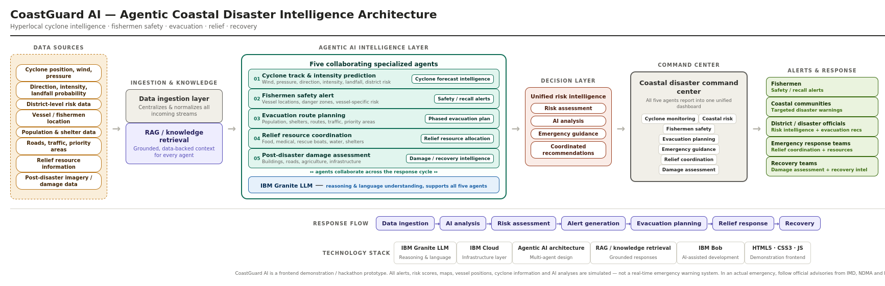
Workflow Architecture-

Slide 10
Role of Agentic AI in the solution
Role of Agentic AI in the Cyclone & Coastal Disaster Early Warning System
Agentic AI enables the early warning system to function as an intelligent, autonomous system rather than a simple alert tool. Using IBM Cloud and IBM Granite LLM, it coordinates multiple specialized agents to deliver hyperlocal disaster intelligence.
Each agent performs a specific role—such as predicting cyclone intensity, alerting fishermen, planning evacuation routes, coordinating relief, and assessing damage—while working collaboratively. This multi-agent approach ensures efficient task execution and accurate, life-saving results.
Agentic AI also brings context awareness, understanding coastline geography, vessel locations, and district population density to generate tailored alerts. It supports real-time adaptation, continuously updating warnings as the cyclone track and intensity change.
Additionally, agents communicate with each other, enabling better-coordinated evacuation and relief decisions.
Overall, Agentic AI makes the system proactive, coordinated, and life-saving, acting like a smart digital disaster commander that helps protect coastal communities.

Slide 11
Novelty and Uniqueness
The proposed early warning system stands out by combining Agentic AI, real-time RAG, and hyperlocal personalization into a single intelligent disaster-response platform.
Multi-Agent Intelligence – Five specialized agents collaborate to deliver cyclone tracking, safety alerts, evacuation planning, relief coordination, and damage assessment.
RAG-Based Accuracy – Integrates real-time IMD/INCOIS data with AI generation, reducing false alarms and misinformation.
Hyper-Personalization – Tailors alerts by district, vessel, and coastal community risk profile.
Real-Time Feedback Loop – Continuously adapts cyclone track and evacuation plans as conditions change.
Multi-Modal Input – Supports text, voice, and SMS-based alerts for low-connectivity coastal areas.
Full Disaster-Cycle Coverage – Spans early warning through post-disaster recovery, not just alerting.
Scalable & Enterprise-Ready – Built on IBM Cloud with IBM Granite LLM, ensuring reliability and governance.

Slide 12
Future Scope
1.Integration with Satellite & Drone Imagery –
The system can be integrated with live satellite feeds and post-cyclone drone imagery to improve landfall prediction accuracy and speed up damage assessment across affected coastal districts.
2.Multilingual Voice & SMS Alerts –
Adding regional-language voice and SMS-based alerts will improve accessibility for fishermen and coastal communities without smartphones or reliable internet access, especially during power and network outages.
·
·
·

Slide 13
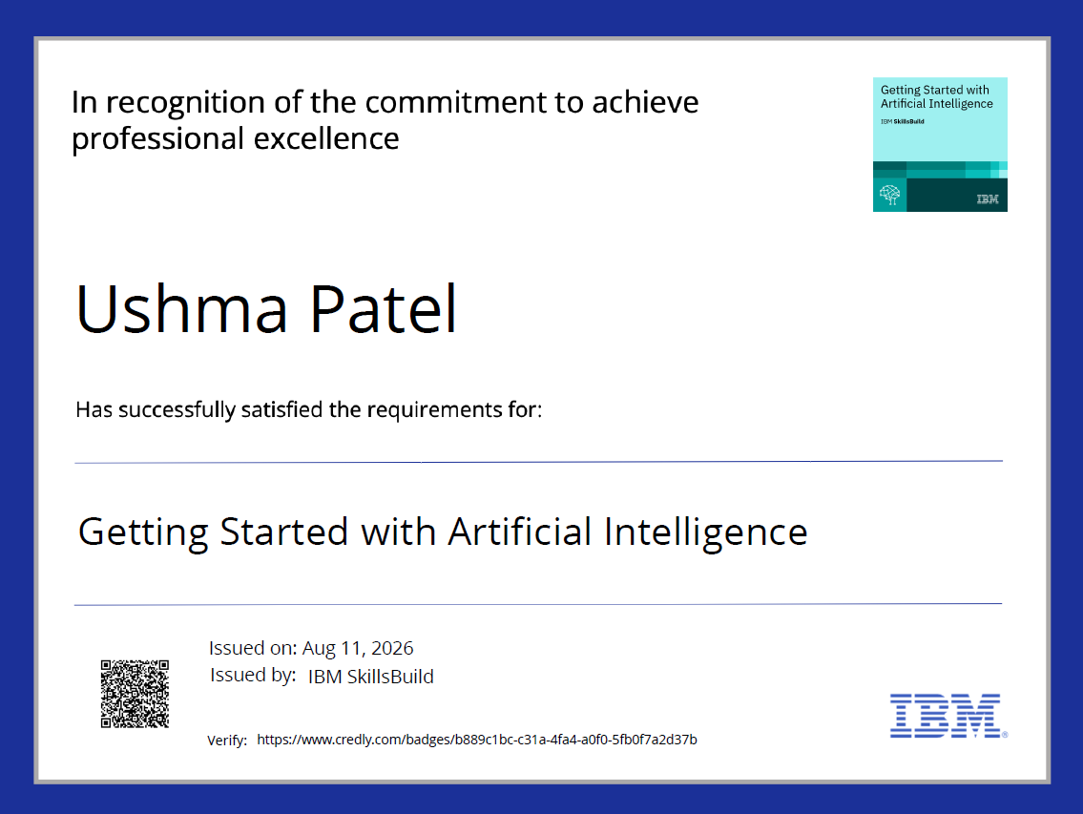
Certificates Earned:

Slide 14
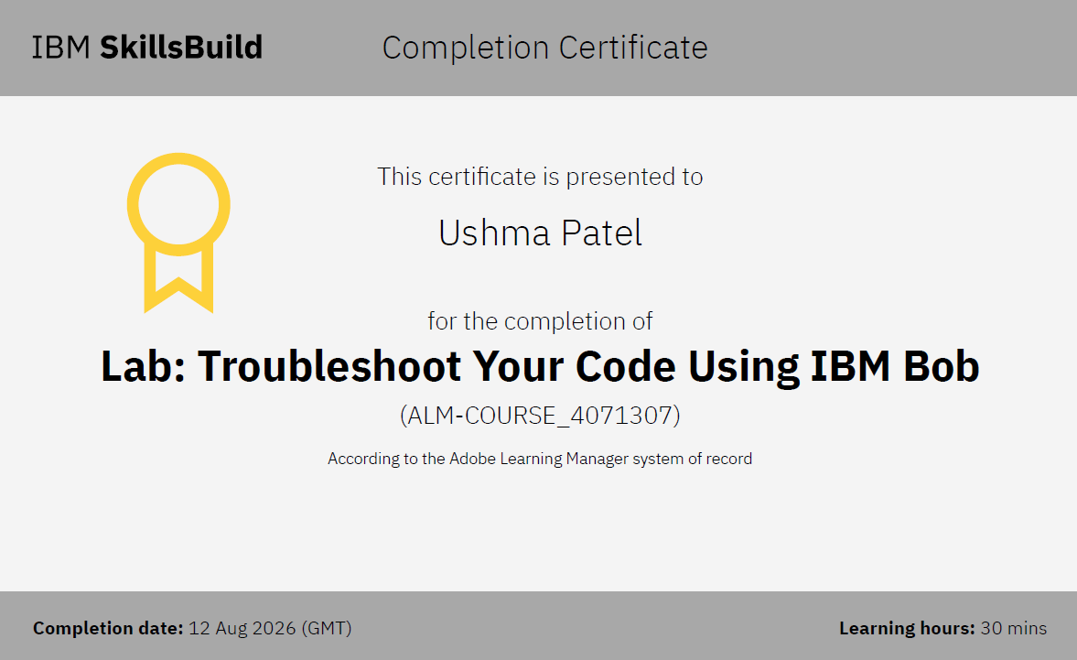
Certificates Earned:

Slide 15


